Slide 1
ICD-10 – Beyond Implementation
The Last Push for ICD-10:
October 1 and Beyond
Angela Boynton
BS, RHIT, CPCO, CCS, CPC, CCS-P, COC, CPC-P, CPC-I

Slide 2
CME Disclosure
The Department of Continuing Education and Certification (DCEC) of the Massachusetts Medical Society has determined that none of the individuals in control of the content of the following CME activities, including faculty speakers, planners, and reviewers have any relevant financial relationships to disclose.

Slide 3

Presenter Bio
Angela Boynton RHIT, CCS, CPC, CCS-P, COC, CPC-P, CPC-I, CPhT
Principal, Boynton Healthcare Management Solutions
Served health information management field for over 10 years
Director of 5010/ICD-10 Communication/Adoption and Training at United Health Group
Adjunct faculty member at Massachusetts Bay Community College
Member of the ICD-10 curriculum development team for AAPC.
Associate’s degree in health information technology
Bachelor’s degree in health care management from Fisher College
Pursuing her Master’s Degree in Health Informatics.

Slide 4
ICD-10 Poll
My greatest concern about ICD-10 is:
  A.) Payer and/or Vendor readiness
  B.) My organization’s readiness
  C.) Medicare’s readiness
  D.) All of the above

Slide 5
Background
HIPAA covered Entities must abide by the final rule that was issued on
January 15, 2009
Summary
January 15, 2009 – Department of Health and Human Services (DHHS) published a final rule requiring covered entities (providers, health plans & clearinghouses) to comply with new code set regulations for:
  International Classification of Diseases, 10th Edition (ICD-10)
    Clinical Modifications (ICD-10-CM) Diagnosis Code Set
    Procedure Coding System (ICD-10-PCS) Inpatient Hospital Procedure Coding System.
  DHHS Compliance Date: October 1, 2015

Slide 6
What’s Wrong with ICD-9?
ICD-9 is outdated; implemented in 1979
ICD-10 codes provide greater detail and increased specificity could produce quality data on diagnostic and procedural trends resulting in improved quality
National E-health initiative and engaging in the full benefit from electronic health record (EHR) systems cannot be achieved without replacing ICD-9
ICD-9 code structure is running out of space
ICD-9 codes do not capture data relating to factors other than disease which significantly limits research capabilities
About 110 other nations have already replaced ICD-9
What characteristics are needed in a coding system?
Flexibility: Has to be able to quickly incorporate emerging diagnosis and procedure codes.
Exactness: In order to identify diagnosis and procedure codes precisely.
ICD-9 is neither of these*
*Pat Brooks
Senior Technical Advisor
CMS

Slide 7
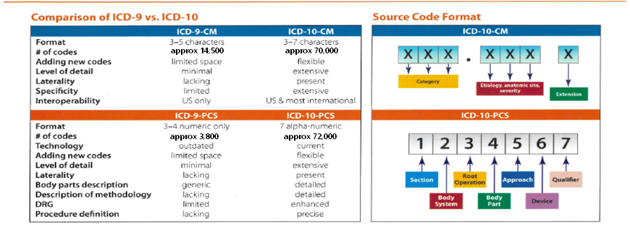


ICD-10 Quick Reference Guide
Implementation Deadline 10/1/2015
W58.11XA Bitten by crocodile, initial encounter →
← W58.01XA Bitten by alligator, initial encounter

Slide 8
Worldwide ICD-10 Adoption (Selected)
1995
1999
2002
1998
1996
United kingdom
France
South Africa
Brazil
Germany
Australia
Russia
China
Canada
2006
Canadian ICD-10 Transition:
Last country to transition
Implemented ICD-10 CA/ CCI only in hospital setting
Went from 3,500 procedure codes to 20,000
5 year transition plan
The Canadian transition was a funded mandate
*AAPC: United States and Italy are the last industrialized nations to not use ICD-10 as their standard for reporting
*Source: American Association of Professional Coders: http://www.aapc.com/ICD-10/icd-10.aspx

Slide 9
ICD-10 is a Date of Service Regulation
  Dual use will begin October 1, 2015
  Due to the “Date of Service” implementation requirement, simultaneous support of ICD-9 and ICD-10 will be required
  Date of service dependent
    ICD-9 codes for dates of service prior to October 1, 2015
    ICD-10 codes for dates of services on or after October 1, 2015
  Dual use will increase operation costs after implementation

Slide 10
Evolution of Healthcare
Healthcare providers face a growing number of documentation and coding challenges amidst changing environment
  Declining reimbursement
  Federal/state payment reforms and quality initiatives are impacting documentation and coding
  Increasing demands for greater documentation specificity
  Coder shortages
  Recovery Audit Contractor (RAC) audits
  Fraud and abuse investigations
  ICD-10 transition
    Decreased coder productivity
    Claims denials/rejections

Slide 11
Where Does ICD-10 Fit?
Common reliance on complete and accurate data and clinical documentation Meaningful Use
  Quality reporting
  Value-based purchasing
  Hospital-acquired conditions
  Payment reform
  Fraud prevention and detection
  Research
ICD-10 will improve quality of data necessary to achieve other healthcare initiatives

Slide 12
ICD-10 Poll
How ready is your practice for ICD-10?
  A.) 100% - Bring it On!
  B.) 75-100% - We still have some last minute work to do
  C.) 50-75% - We are working on it
  D.) Less than 50% - We may not be ready for October 1, 2015

Slide 13
The Road to ICD-10…
…is paved with documentation focus areas
  Specificity
  Granularity
    Disease type
    Disease acuity
    Disease stage
    Site specificity
    Laterality
    Missing combination code detail
    Changes in timeframes associated with familiar codes

Slide 14
ICD-10 Specificity Examples
S31.140D Puncture wound of abdominal wall with foreign body, right upper quadrant without penetration into peritoneal cavity, subsequent encounter
T82.6xxA Infection and inflammatory reaction due to cardiac valve prosthesis, initial encounter
Z89.411 Acquired absence of great right toe
Z57.0 Occupational exposure to noise
Z63.71 Stress on family due to return of family member from military deployment
Y38.811A Terrorism involving suicide bomber, public safety official injured, initial encounter

Slide 15
Other Issues…
Vendor Survey
Physician Documentation
Revenue Cycle/Operations
Payer Readiness
Denials
Appeals Strategy

Slide 16
ICD-10 Poll
How many have surveyed vendors & payers to gauge their overall readiness for ICD-0?
  A.) We’ve surveyed vendors
  B.) We’ve surveyed payers
  C.) We’ve surveyed both
  D.) We’ve not had time to reach out to either

Slide 17
ICD-10 Vendor Survey – It’s never too late!
Plan ahead for possible systems remediation down time
Who are the ICD-10 contact people and their contact information?
What modifications to my EMR must be made in order to accommodate ICD-10? And when will system upgrades for ICD-10 go into effect?
Will system upgrades for ICD-10 require additional hardware to support the software modifications?
Besides system upgrades, what additional documentation and forms changes will you provide and what degree of customization will you assist our organization? (Matrices, Clickable templates, etc.)
Will there be any additional training needed as a result of the ICD-10 upgrade?
Will there be any additional fees charged as a result of the ICD-10 upgrade or necessary training?
How will your products and services accommodate both ICD-9 and ICD-10 as we work with claims for services provided both before and after the transition deadline for code sets.
Does our license with you include ICD-10 regulatory updates on a moving forward basis after the ICD-10 go live?
What does testing mean to your organization and when will we be able to test ICD-10 claims/transactions and have you engaged in testing with payers we do business with?
What are you contingencies if there is system wide outage or downtime?
ICD-10 Mitigation Strategy – Knowing What Questions to Ask.
ICD-10 Challenge
ICD-10 Remediation/ Action
Notes:
Recognize that ICD-10 is Likely to have a Significant Technological Impact
Engage Your Vendors—And Don’t Let Them Tell You—Make Them Demonstrate Their Readiness
Prepare for Dual Processing for a Time Post Transition
Prepare for System Down Time Pre Transition
17

Slide 18
Physician Documentation
It is imperative that providers’ and nurses’ clinical documentation be very good.
  Claims that usually drop within 3 to 5 days could potentially take 7 to 10 days before dropping.
  Coders often can not release the claim until queries are returned by the providers and nurses.
  If there is an increase in queries needed from the providers, this will add to number of days before a claim is ready to drop.

Slide 19
Documentation Challenges
Ensuring sufficient documentation to support code assignment while allowing providers to document in clinical, not coding, terms
Need good clinical documentation – not a greater volume of documentation

Slide 20
Conduct a Documentation Gap Analysis
Evaluate medical record samples to determine whether documentation supports level of detail found in ICD-10-CM
Sampling techniques could include:
  Random samples
  Sampling by clinical specialty
  Top diagnoses/procedures
  Top service lines
  High volume diagnoses/procedures
  High dollar diagnoses/procedures
  Diagnostic categories known to represent documentation problems with ICD-9-CM
Establish a baseline for productivity in coding now to understand the impact ICD-10 will have after the transition

Slide 21
Benefits of Documentation Improvement
Better documentation to support multiple purposes \
Improved ICD-9-CM coding
Smoother transition to ICD-10-CM/PCS Collaborative approach to successful transition
  Fewer coding errors
  Increased coding productivity
  Reduced physician queries
  Fewer claims denials/rejections
  Opportunity to incorporate documentation details into EHR system

Slide 22
Documentation Improvement Strategies
Identify documentation improvement opportunities that could impact various initiatives, including ICD-10, Meaningful Use, value-based purchasing, present on admission and hospital-acquired condition reporting
Determine best solution for addressing each documentation gap – one size doesn’t fit all
  Examples:
    Modifications to form or template
    System prompts
    Education
    Workflow or operational process changes
Prioritize – start with the “low hanging fruit” or issues with greatest impact

Slide 23
Documentation Improvement Strategies (cont’d)
Identify and implement changes in documentation capture processes that would facilitate improvements in clinical documentation practices
  Such as;
    Use of EHR documentation templates and prompts
Key to quality care is to focus on capturing quality information at the point of care
Improving clinical documentation now has immediate benefits

Slide 24
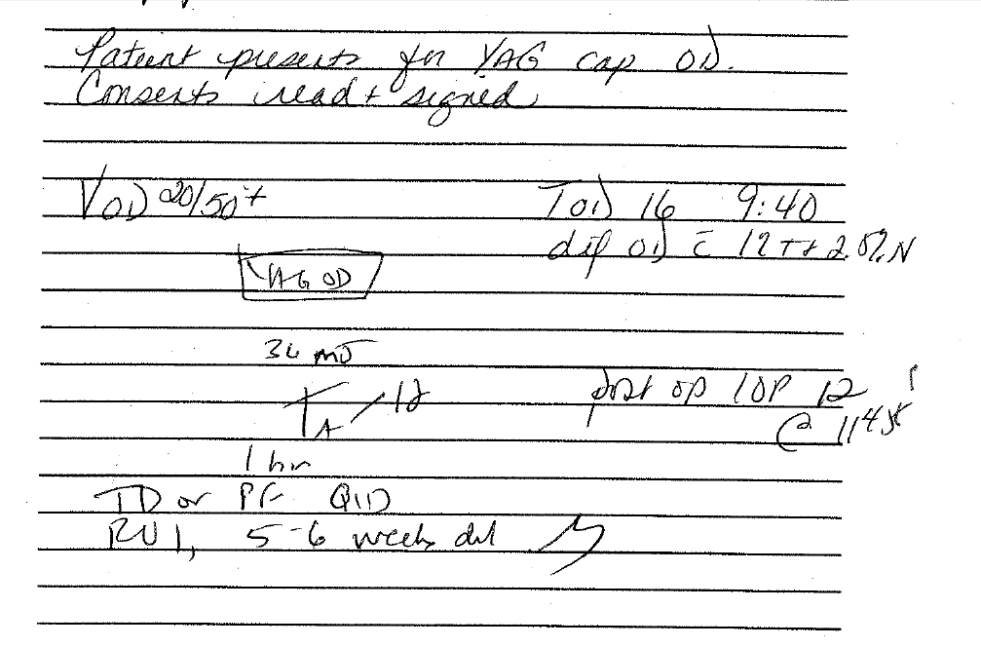
Example:
What not to do
As always, legibility remains a factor!

Slide 25
Take Note
Accurate data on severity, risk, quality, and outcomes depends on complete, accurate coding and documentation
Non-specific documentation results in non-specific code assignments
ICD-10 should be used to set the “gold standard” for clinical documentation

Slide 26
Revenue Cycle/Operations
What you can do to prepare:
  Ensure your physician order, scheduling, and registration processes and systems store chief complaints in code format today, consistently, with no free text.
  Ensure that your Pre-Registration and Registration staff learn ICD-10 and assemble an “ICD-10 Pre-Cert/Auth Group” that keeps up monthly, during the transition, on any changes to payer rules around those rules.
  Ensure a strong denial management process where denial outcomes are shared monthly with all departments, and focus on identifying where ICD-10 training gaps have created denials.

Slide 27
Payer Readiness
The majority of payers are seeking full compliance with the ICD-10 regulation on October 1, 2015 (See Appendix for Additional Detail)
Areas of Concern include:
  Non-covered entities
    Workers Comp
      Contact your local WC, some are ready to accept ICD-10 codes
    Auto Insurance
      Plan to map information within the practice

Slide 28
Denials
Early snags in ICD-10 processing will undoubtedly depress cash-flow due to processing issues and immediate denials.
Expect denials to increase 100-200% during the initial phase of implementation due to:
  Lower productivity
  Data entry errors
  New payer regulations
  Crosswalk interpretation challenges

Slide 29
Avoid Denials
Establish a ‘war room’ team going into ICD-10 with clear role assignments
Look at current reporting/tracking mechanisms- e.g., pre-auths/pre-certs
Establish escalation process for recognized ICD-10 issues
How will you respond to Payer issues?
  Poor Payer response
    Pre-auth/Pre-cert appeals letters
Know payer updates – staff must have access

Slide 30
Appeals Strategy
Avoid the ICD-10 Perfect Storm
Denial Avoidance
  Process improvement for Pre-Auths/Pre-Certs
Denial/Appeal Success:
  Identify Issue
  Know the payer’s appeal process
      Tiered Appeals
        Level I Appeals vs Level II Appeals

Slide 31
Appeals Strategy
Vigilance will be needed and the must be knowledge and review of contracts with Payers.
Know your payer’s appeal process
Know your payer’s regulatory body (DOI, etc.)
If it gets bad consider outsourcing the Appeals Process

Slide 32
Sample Appeals Text
Sample Pre-Auth/Pre-Cert appeal letter - No response:
“Our practice requested pre-authorization from your organization in regards to the care for the above listed patient on (date). To date no response has been received from your company.
Your failure to promptly respond to the request breeches industry recognized standards of care management and accreditation standards. We seek resolution to this matter immediately.”
Pre-auth/Pre-cert denials delay care.

Slide 33
Appeals Process
What should we appeal?
Potentially review appeal thresholds
  EMR/Practice Management System/Encoder
  Anticipate many more coding related denials
  Technology is your friend in this process
  Look for trends – and be ready to appeal drastic variations in:
    Conditions/Code – bundling/mismatch/down coding
    Payers – anticipate Medicare denial rates to shift
    Procedures – for revenue neutrality – most common procedures
      Payer contracts will be crucial in this discussion

Slide 34
Appeals Process
Demand coding guidelines/authorities that the payers are using
  Consistency is key in how payers apply the rules
  Cite your coding (or other) authority in your appeal letter
  “If your organization used published coding guidelines, please provide the publisher and section so that we may verify the accuracy of these rules and application”

Slide 35
APPENDIX - Payer Readiness
Anthem
  Working to ensure successful business processes, policies, and procedures the ICD-10 implementation
  They will strive to have no delays or interruptions
  Able to receive ICD-10 claims on October 1, 2015
https://www.anthem.com/wps/portal/ca/provider?content_path=provider/f1/s0/t0/pw_e169344.htm&label=ICD-10%20Updates

Slide 36
APPENDIX - Payer Readiness
Aetna
  Plans to meet all compliance timeframes
  Will continue to work with providers and clearinghouses in order to best prepare for the ICD-10 implementation
https://www.aetna.com/health-care-professionals/icd-10-5010-npi-information/icd-10-faqs.html

Slide 37
APPENDIX - Payer Readiness
BMCHP (Boston Medical Center HealthNet Plan)
  Will only accept ICD-10 codes comprising upper case characters. Any claim submitted with ICD-10 codes comprising lower case characters will be denied.
  Will deny all claims that are billed with both ICD-9 and ICD-10 diagnosis codes on the same claim.
  Will only accept appropriate codes based on date of service for outpatient claims
  http://www.bmchp.org/providers/claims/icd-10-info

Slide 38
APPENDIX - Payer Readiness
BMCHP (Boston Medical Center HealthNet Plan)
  Will only accept ICD-10 codes composed of upper case characters.
  Will deny any claim that is submitted with ICD-10 codes composed of lower case characters or a mix of both upper and lower case characters.
http://www.bmchp.org/~/media/dbb72153afc64bb28ccf35a561ffa922.pdf?#

Slide 39
APPENDIX - Payer Readiness
BCBS MA
  Plans to be ready for the October 1, 2015 transition to ICD-10
  Prior to October 1, will continue to be fully compliant with existing CMS regulations
  Claims submitted with ICD-10 codes prior to October 1, 2015 will not be accepted.

Slide 40
APPENDIX - Payer Readiness
BCBS MA
Participated in MHDC Collaborative Testing Program
No longer engaging in End-to-End Testing
Launched a self-service Acknowledgment Testing offering to validate ICD-10 EDI claims submissions.
https://provider.bluecrossma.com/ProviderHome/portal/home/office-resources/billing-and-reimbursement/icd-10/

Slide 41
APPENDIX - Payer Readiness
FCHP
  Working with providers and partners to implement the ICD-10 conversion.
  Completed mapping of current ICD-9 codes to ICD-10 as well as ICD-10 to ICD-9 codes.
  Appropriate updates to our policies, rules, and system configuration.
  A comprehensive end-to-end testing strategy.
  Training and education for employees and providers
  Closely collaborating with covered entities within Massachusetts, including providers, other payers and clearinghouses to ensure a smooth transition through comprehensive testing and education efforts
http://www.fchp.org/providers/announcements/ICD-10.aspx

Slide 42
APPENDIX - Payer Readiness
Neighborhood Health Plan
  Full Compliance by 10/1/2015
  NHP completed a systems upgrade that enabled ICD-10 compliance as of 1/1/2012
  The initial EDI testing for upfront pass/fail ICD-10 submission is available from NHP
https://www.nhp.org/provider/Documents/NHPICD-10ReadinessFAQs.pdf

Slide 43
APPENDIX - Payer Readiness
United Healthcare
  Full regulatory compliance
  Transition neutrality
  Full recommendation for native processing
  Trade partner testing
https://www.unitedhealthcareonline.com/b2c/CmaAction.do?channelId=6fa2600ae29fb210VgnVCM1000002f10b10a____

Slide 44
APPENDIX - Payer Readiness
Humana
  Accurate use of ICD-10 coding for claims submitted on or after the compliance date
  Vendor readiness to support ICD-10 early enough for providers to prepare
  Delegate/provider readiness to submit fully loaded encounter data
  Rendering providers’ readiness to support ICD-10 on or after the compliance date
  They will strive to have no delays or interruptions
https://www.humana.com/provider/medical-providers/education/claims/icd-10/

Slide 45
APPENDIX - Payer Readiness
Cigna
  Providing healthcare professionals with information and support regarding the ICD-10 transition
  Collaborating with our trading partners and vendors to support the transition to ICD-10
  Completing business readiness monitoring and plans and training
http://www.cigna.com/medicare/healthcare-professionals/icd-10

Slide 46
APPENDIX - Payer Readiness
MassHealth
  Will implement on October 1, 2015
  Actively engaged in testing - test files no longer accepted after 8/31/2015
  Using the month of September to resolve any remaining testing issues before implementation.
  Updated billing guides available on their website
http://www.mass.gov/eohhs/gov/newsroom/masshealth/providers/icd10-implementation.html

Slide 47
Questions?
Angela Boynton
BS, RHIT, CPCO, CCS, CPC, CCS-P, COC, CPC-P, CPC-I
Principal, Boynton Healthcare Management Solutions, LLC
BoyntonHMS@gmail.com

Slide 48
Next Steps
    After 48 hours you will receive a link to the online evaluation
    Please complete the evaluation and provide your feedback
    After completing the evaluation, you will be directed to the MMS CME Certificate portal where physicians can claim CME credit (others receive a certificate of attendance)

Slide 49
Thank you to our virtual exhibitor
Mindleaf Technologies, Inc. www.mindleaf.com

