Slide 1
Financial Management of Practices Case Studies
A case study series
Jim Heffernan, Sr. VP Finance & Treasurer
MGPO
June 2, 2013

Slide 2


Slide 3
Case Review
Module 3 - Compensation Planning Case Study

Slide 4
What are the potential advantages or disadvantages of an RVU based compensation model?
Pays physicians regardless of financial mix
Weights services consistently

Slide 5
What other options for compensation might Mark propose and what would be their advantages?
What is the right structure for compensating physicians in the future?
What is the right percent of compensation to have as (at risk) incentives?
What is the right balance of measures to include as incentives?
  - Volume/RVUs - Panel Size
  - Managing Total Medical Expense - Patient Experience
  - Quality - Compliance
  - Coordination of Care - Adoption of best practices
  - Access
How do we incentivize and preserve our research and teaching missions?
Time Frame for change?

Slide 6
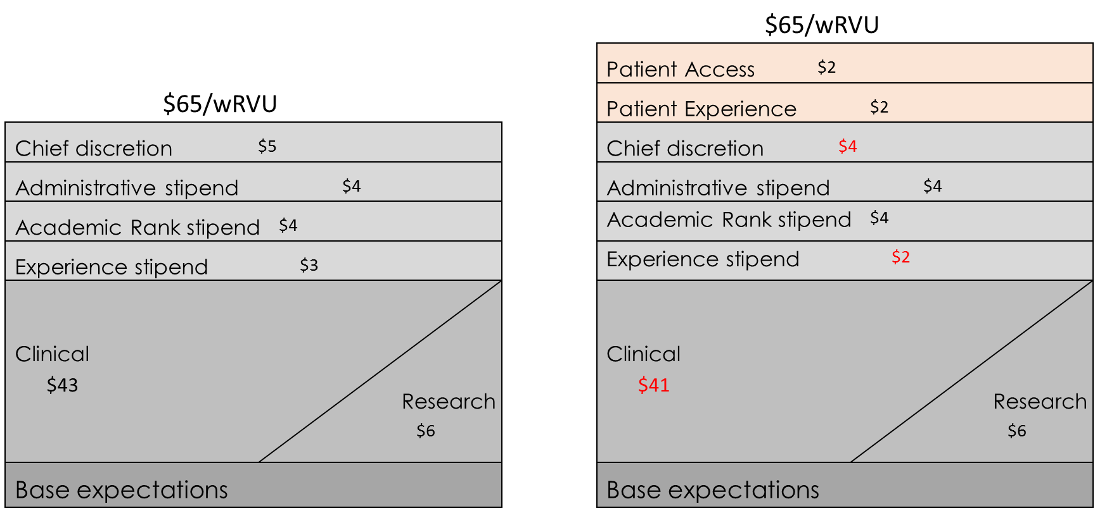
How can Mark integrate new incentives for improved quality and access with no new marginal funds available to the practice?
Requires value judgments
Incentives change over time

Slide 7
How much can RVUs be devalued before they are no longer an incentive?
Does professionalism mitigate the value of the RVU
Consider the theory of target compensation
Do quality, safety or population management incentives provide assurance of compensation stability

Slide 8
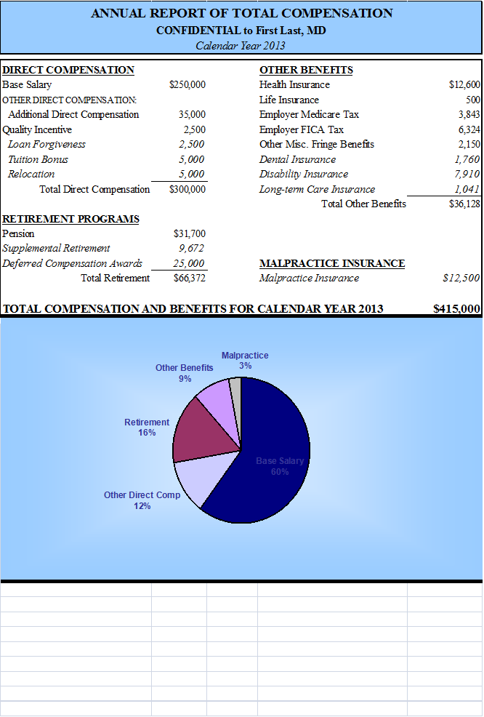
Should Mark change the subsidy for fringe benefits to provide additional funding for cash compensation?
Maximize retirement tax advantages
Provide current income

Slide 9
Follow-up resources
Medical Group Management Association – sponsors surveys of cost, productivity, high performing practices and compensation surveys
Faculty Practice Solution Center (UHC) – sponsors clinical productivity, revenue cycle and billing office performance surveys
Healthcare Financial Management Association – MAP surveys of practice performance including financial and revenue cycle
Sullivan Cotter – maintains the former large clinic compensation survey
American Association of Medical Colleges – surveys of faculty practice plan compensation
American Medical Group Association – compensation survey
Specialty societies may have additional information

Slide 10
Questions and comments?
Acknowledge the contributions to the cases by Michael Mercurio, Mario Dibenedetto, DeeDee Chen, and Dr. Creagh Milford and to Nan Jones for the concept of the program

